Slide 1
Master Thesis
Semantic Segmentation of Land Use with High-Resolution Orthophotos and Convolutional Neural Networks
Faculty of Mathematics and Computer Science
Karsten Köhler, Student ID No. 8690570

Slide 2
Research Question
Background
Emergency Landing Assistant at FernUniversität in Hagen
Primary Objective
Semantic Segmentation of Land Use
Comparison of Deep Learning Architectures
Secondary Objective
Vegetation Density Analysis with Spectral Indices

Slide 3
Content
Image Segmentation
Vegetation Analysis
Literature Review
Convolutional Neural Network
Reference Architectures
Dataset
Raster Preprocessing
Label Preparation
Experiments
Implementation
Metrics
Segmentation Results
Discussion
Literature Review
Spectral Vegetation Indices
Experiments
Implementation
Visualizations
Discussion

Slide 4
Image Segmentation
Literature Review
Faculty of Mathematics and Computer Science
Karsten Köhler, Student ID No. 8690570

Slide 5
Convolutional Neural Networks
special subclass of Deep Neural Networks
highly efficient on grid-like data like images
extensive reuse of parameters
consists of convolution / pooling layers
Recurrent Neural Networks
Generative Adversarial Network
Auto-encoder
Neural Networks
Convolutional Neural Networks
…

Slide 6

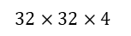

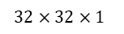
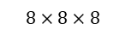
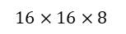
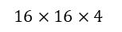
Example CNN Architecture
alternating convolution/pooling layers
extract high-level features
only class predictions, no segmentation so far
FCN by omitting fully-connected layer, result is low-resolution heatmap
$$32×32×1$$
$$32×32×4$$
$$16×16×8$$
$$8×8×16$$
$$1×1×k$$
$$16×16×4$$
$$8×8×8$$
Conv.
Pool.
Conv.
Pool.
Conv.
Full
Class Predictions
Input Image

Slide 7
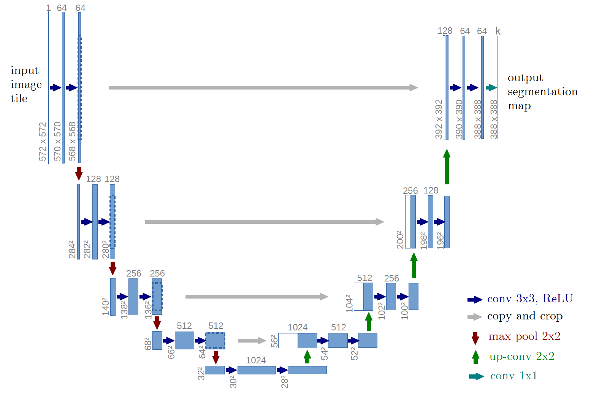
U-Net Architecture
contracting and expanding path
skip connections between paths
segmentation map is smaller than input image
Ronneberger et al. (2015)

Slide 8
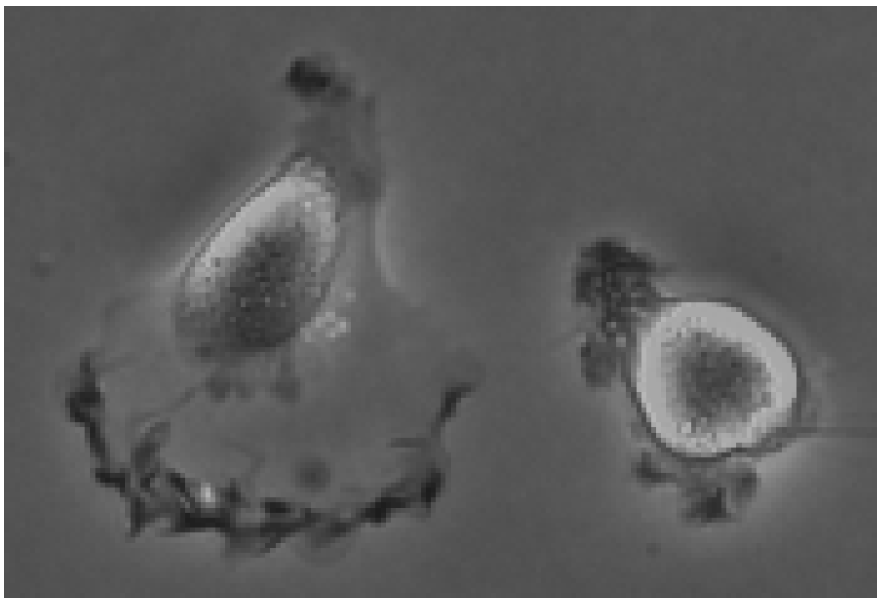
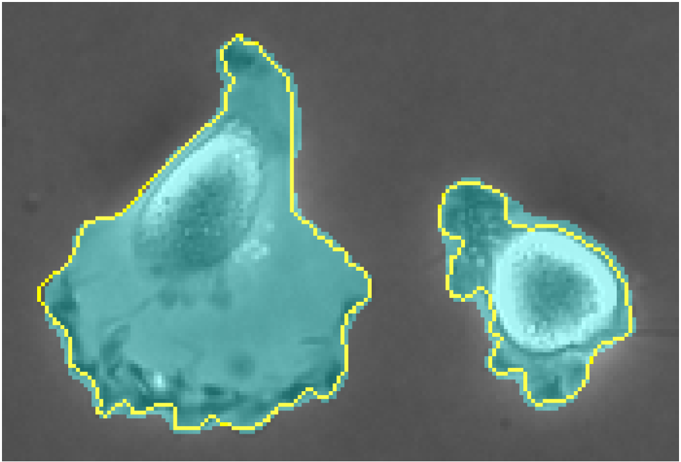
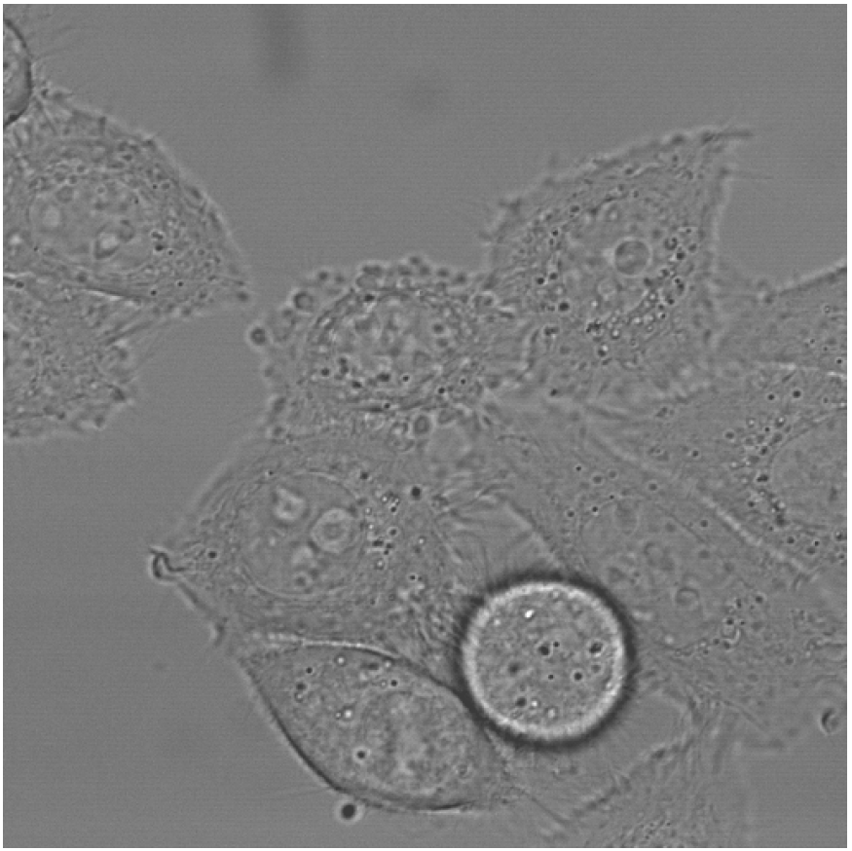
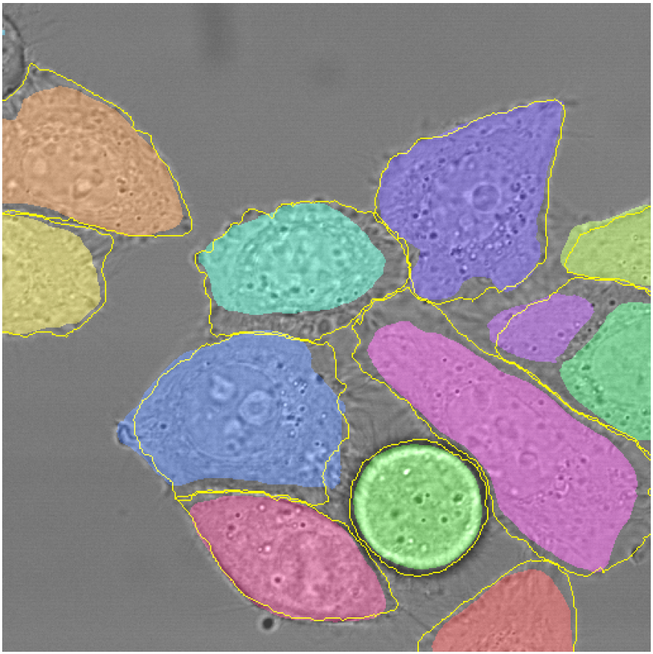
U-Net on ISBI Cell Tracking Challenge 2015
DIC-HeLa 77.56% average IoU
PhC-U373 92.03% average IoU
Ronneberger et al. (2015)

Slide 9
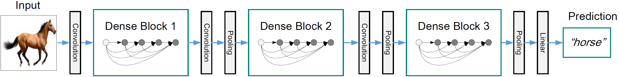
DenseNet Architecture
originally designed for image classification
introduced components called Dense Blocks
dense connectivity increases information flow and computational efficiency
Huang et al. (2017)

Slide 10
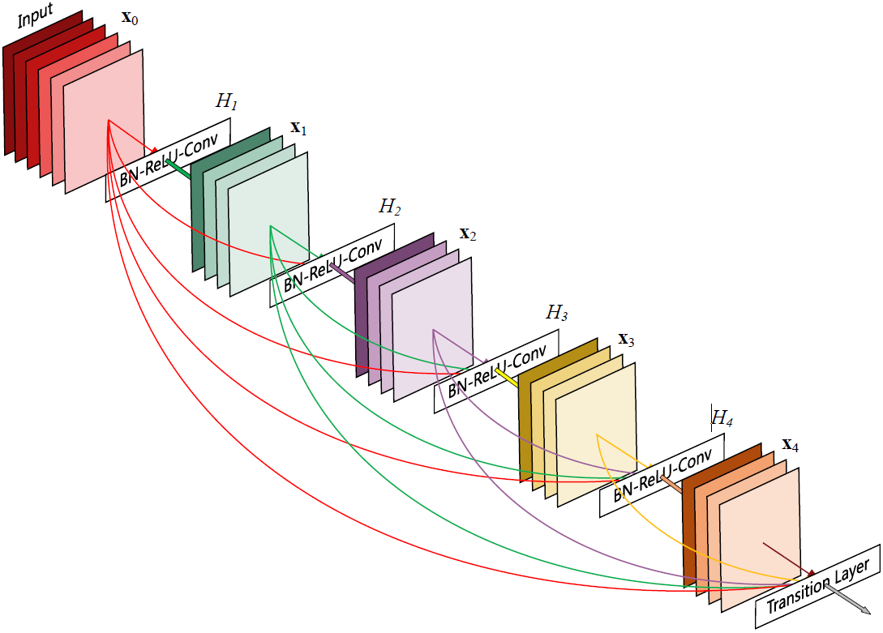
DenseNet Architecture – Dense Blocks
direct connections to all subsequent layers
growth rate determines new feature maps per step
transition layer at the end for downsampling
optional: compression in transition layer
Huang et al. (2017)

Slide 11
FC-DenseNet Architecture
Input
Output
Convolution
Convolution
Layers | Feature Maps
Input | 3
3x3 Convolution | 48
Dense Block (4) + Transition Down | 112
Dense Block (5) + Transition Down | 192
Dense Block (7) + Transition Down | 304
Dense Block (10) + Transition Down | 464
Dense Block (12) + Transition Down | 656
Dense Block (15) | 896
Transition Up + Dense Block (12) | 1088
Transition Up + Dense Block (10) | 816
Transition Up + Dense Block (7) | 578
Transition Up + Dense Block (5) | 384
Transition Up + Dense Block (4) | 256
1x1 Convolution | c
Dense Block
Dense Block
C
Skip Connection
C
Transition Down
Transition Up
Dense Block
Dense Block
C
Skip Connection
C
Transition Down
Transition Up
Dense Block
Jégou et al. (2017)

Slide 12
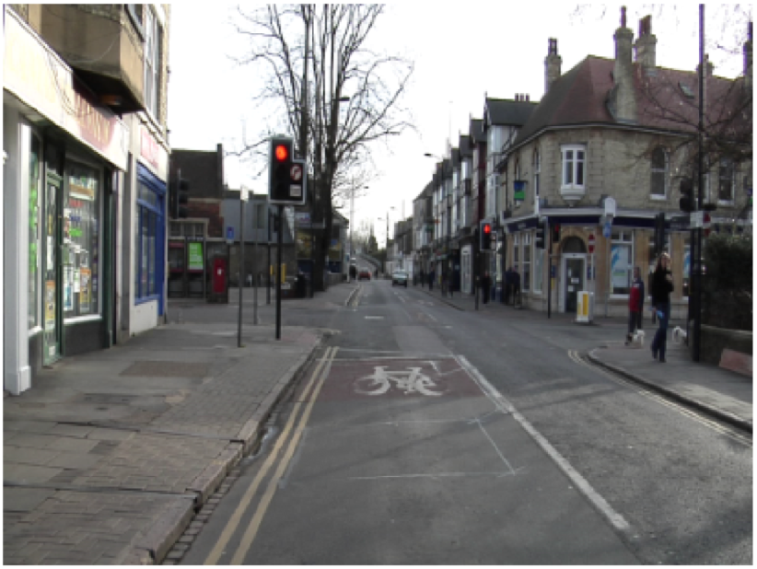
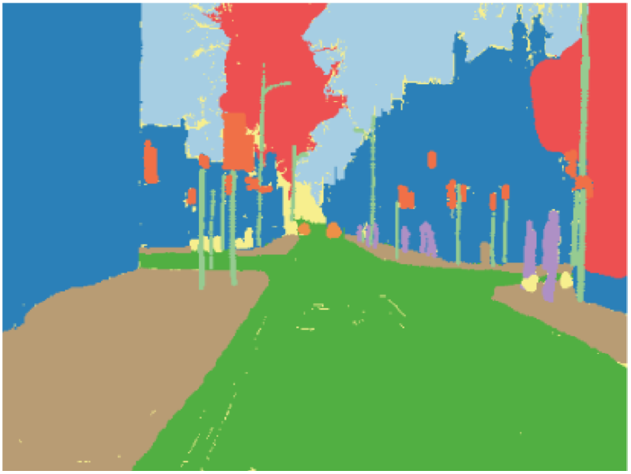
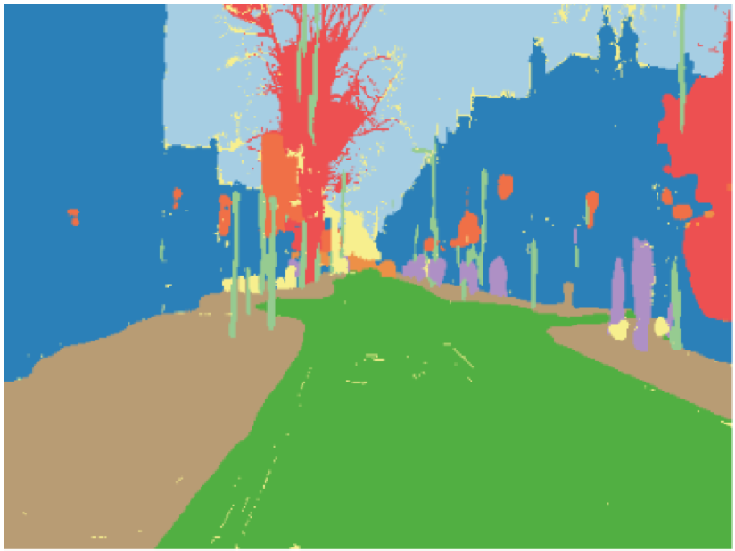
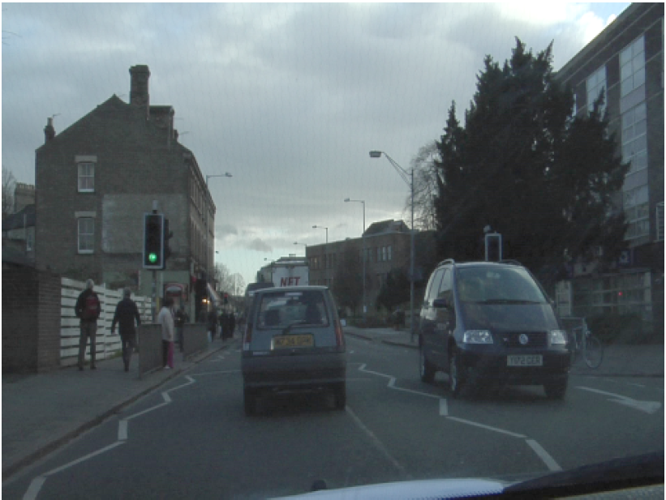
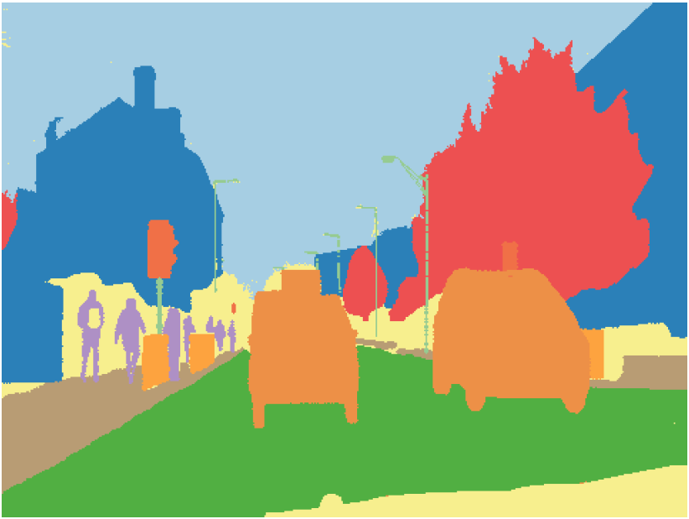
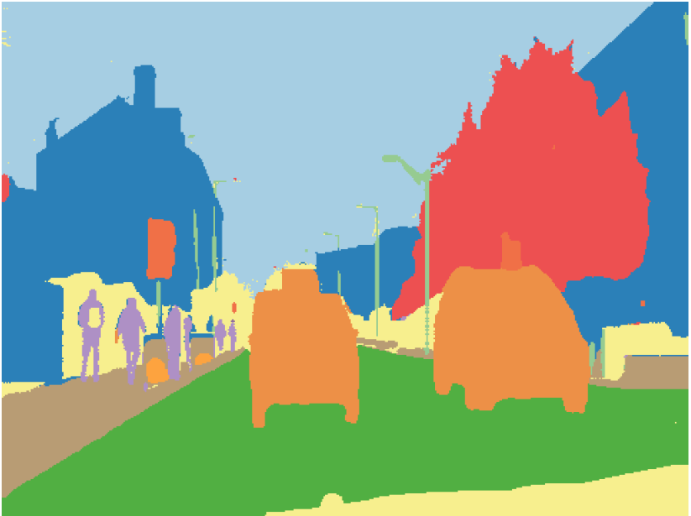
FC-DenseNet on CamVid Dataset
 | Parameters (M) | Mean IoU (%) | Gl. Accuracy (%)
Model
FC-DenseNet56 | 1.5 | 58.9 | 88.9
FC-DenseNet67 | 3.5 | 65.8 | 90.8
FC-DenseNet103 | 9.4 | 66.9 | 91.5
Original Image
Ground Truth
Prediction
Jégou et al. (2017)

Slide 13
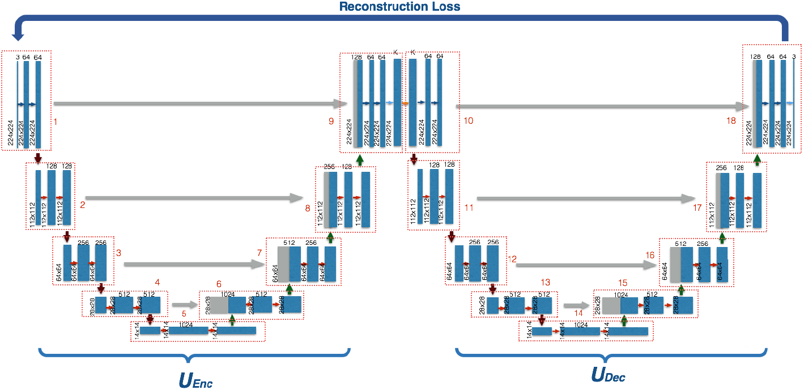
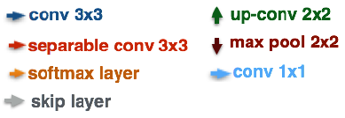
W-Net Architecture
unsupervised learning approach
split into encoder and decoder parts
only encoder is used for inference
Postprocessing with Conditional Random Fields and Hierarchical Segmentation
Xia et al. (2017)

Slide 14
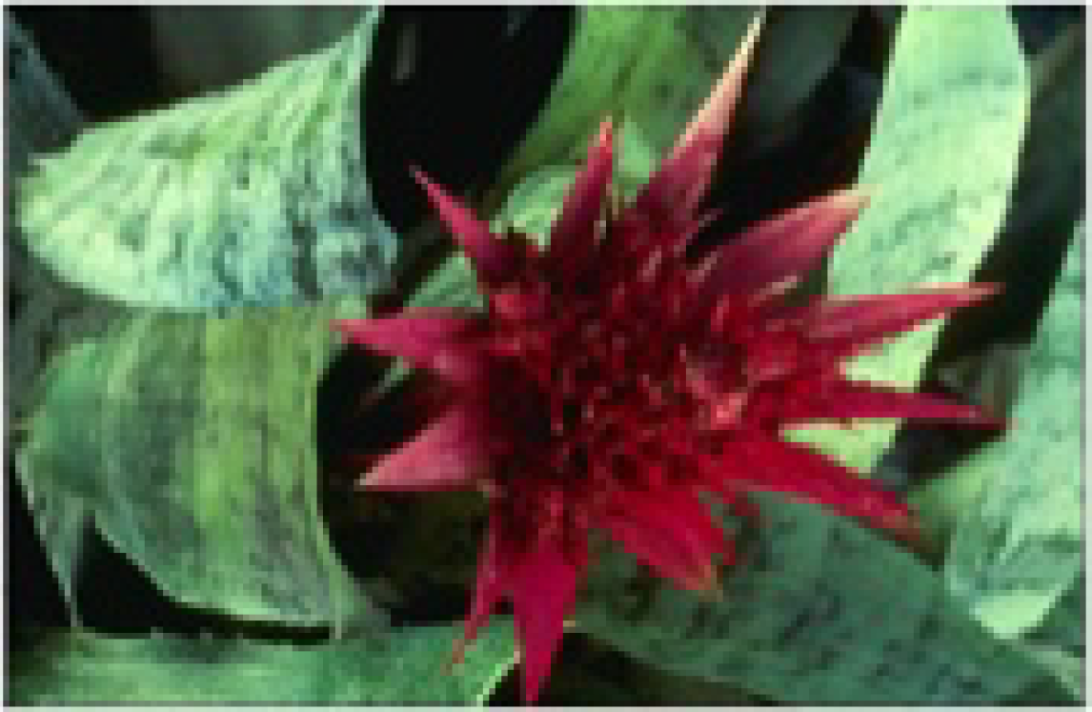
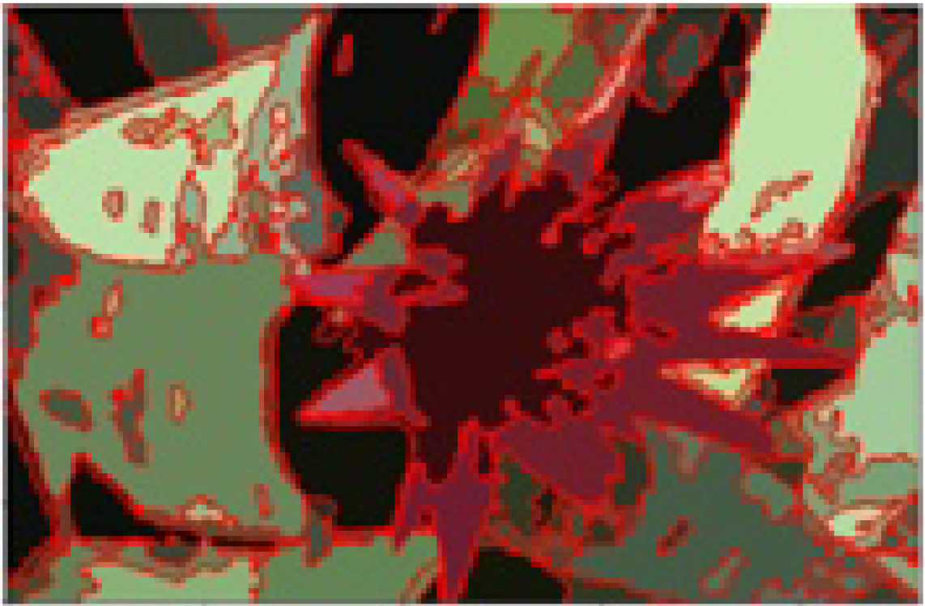
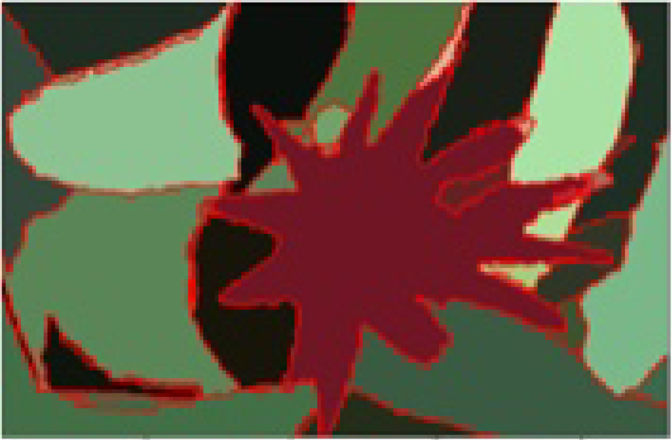
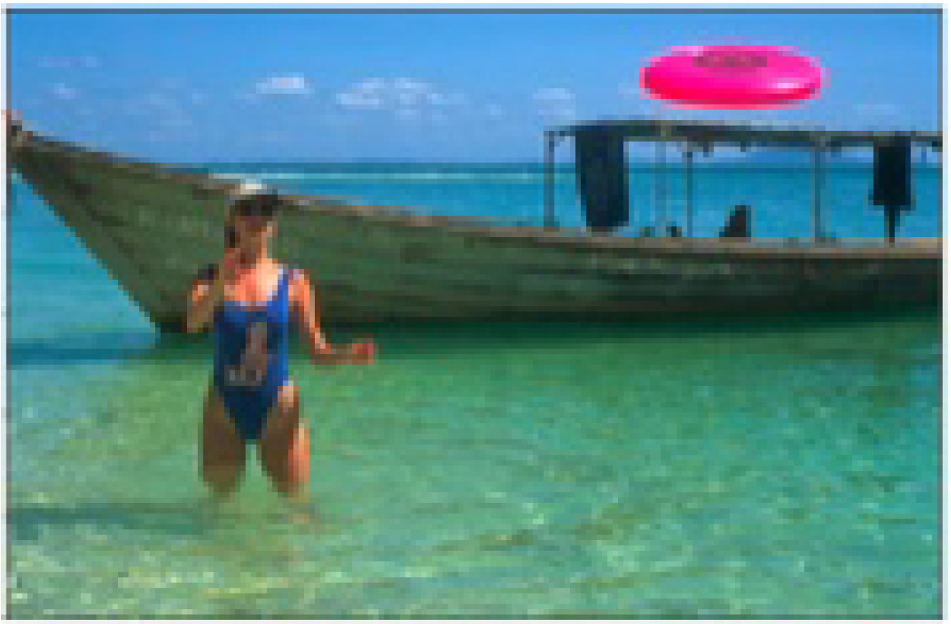
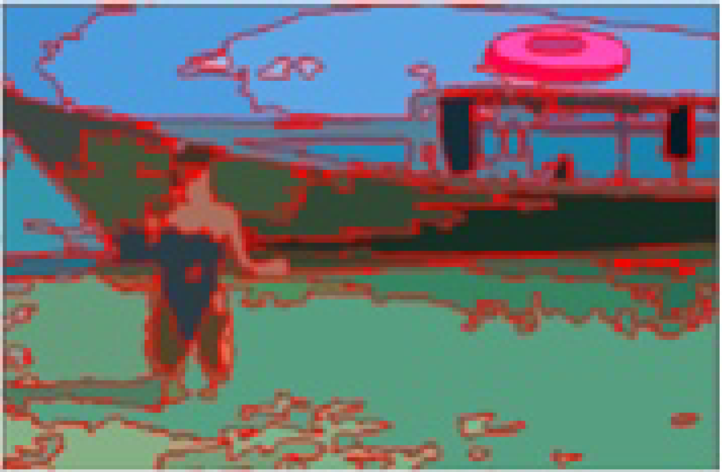
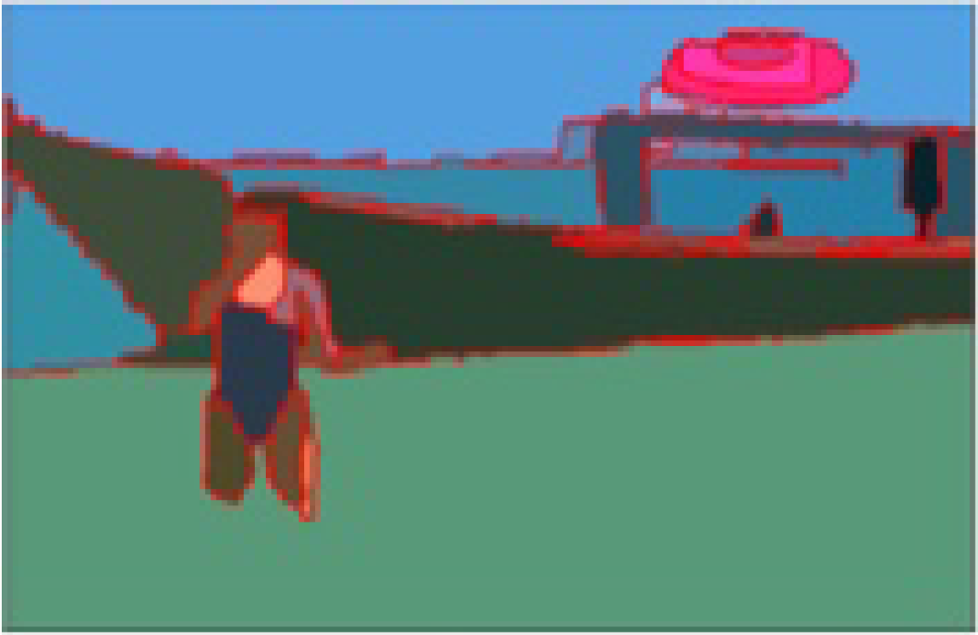
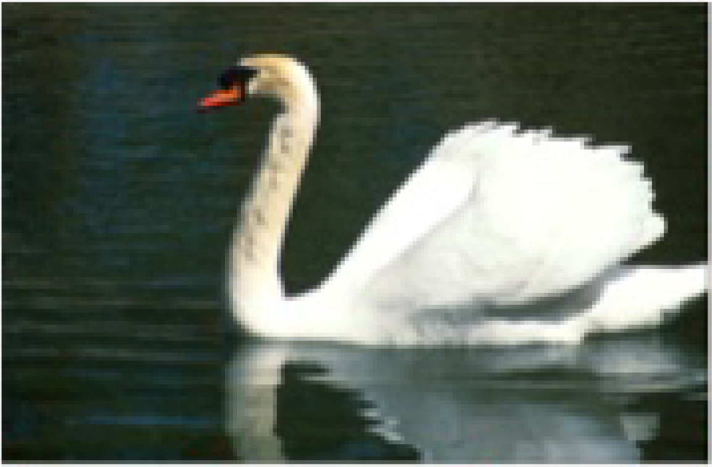
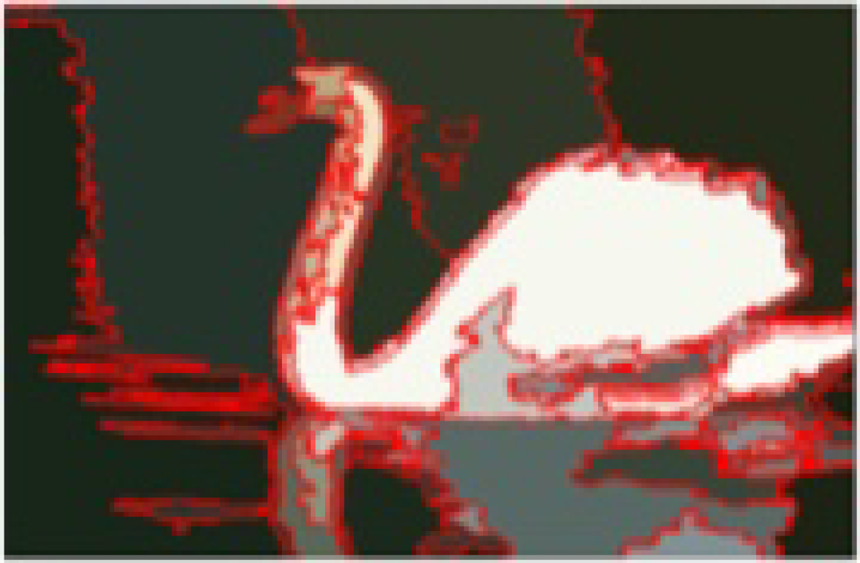
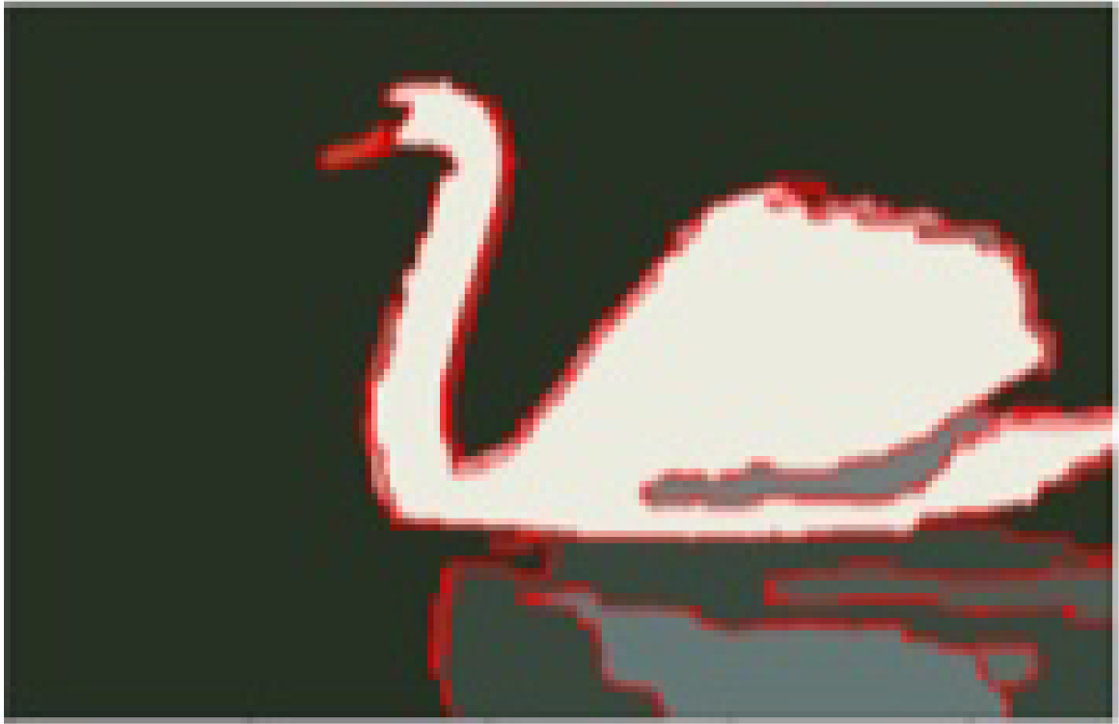
W-Net on BSDS500
Model | Segmentation Covering | Probabilistic Rand Index | Variation of Information
W-Net | 0.62 | 0.84 | 1.60
W-Net + PP | 0.64 | 0.85 | 1.47
Original Image
W-Net Prediction
After Postprocessing
Xia et al. (2017)
Notes:
The Rand index is a measure of the similarity between two data clusterings.
variation of information or shared information distance is a measure of the distance between two clusterings

Slide 15
Image Segmentation
Dataset Preparations
Faculty of Mathematics and Computer Science
Karsten Köhler, Student ID No. 8690570

Slide 16
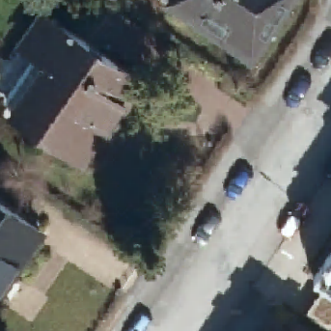
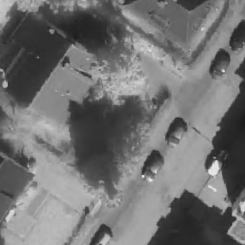
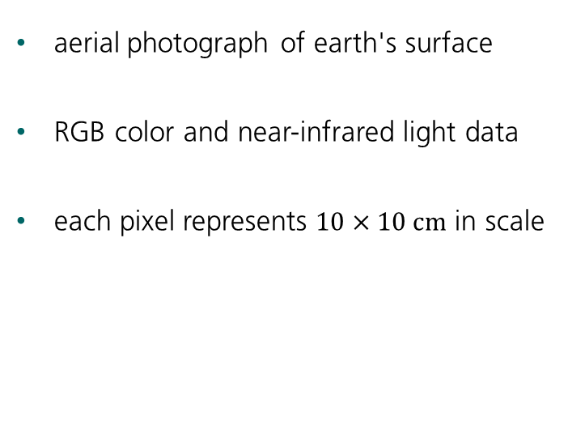
Digital Orthographic Photographs
aerial photograph of earth's surface
RGB color and near-infrared light data
each pixel represents $10×10 cm$ in scale
30 m
RGB Color
NIR values

Slide 17
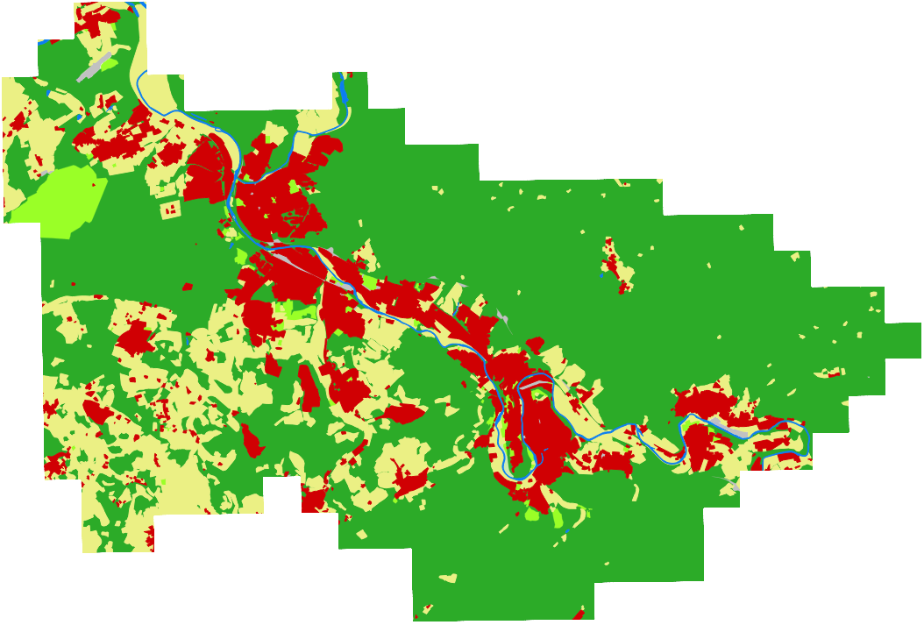
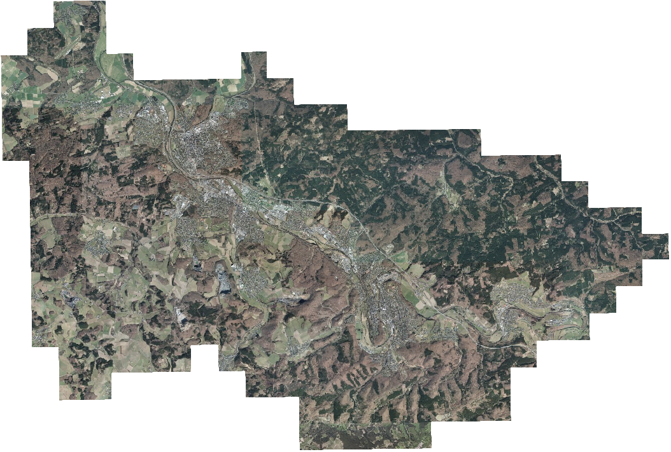
Raw Image Data
Total Area: 248.49 km²

Slide 18
Vector Graphics with Land Use
water
buildings
agriculture
forest
urban greens
traffic

Slide 19
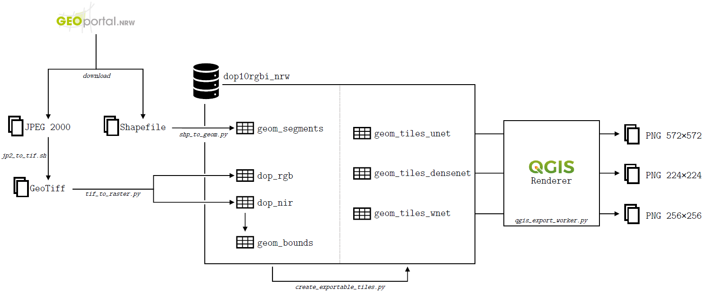
Data Preparations

Slide 20
Final Datasets
U-Net
572x572 pixels
20,289 training images
4,679 test images
FC-DenseNet
224x224 pixels
38,367 training images
8,512 test images
W-Net
256x256 pixels
32,861 training images
7,405 test images

Slide 21
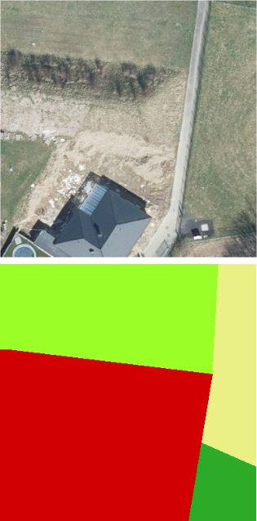
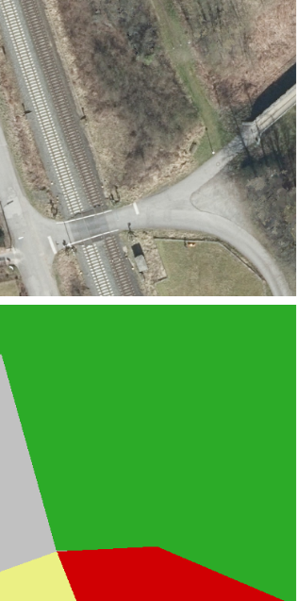
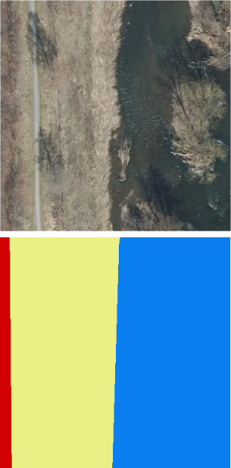
Inaccuracies in the Ground Truth
buildings class includes land parcels
roads and railways submerged in surrounding class
riverbanks delineated poorly
Original Image
Ground Truth

Slide 22
Class Imbalance
forest, agriculture and buildings make up 97% of all data
many training samples only consist of one class
could not be compensated with class weights

Slide 23
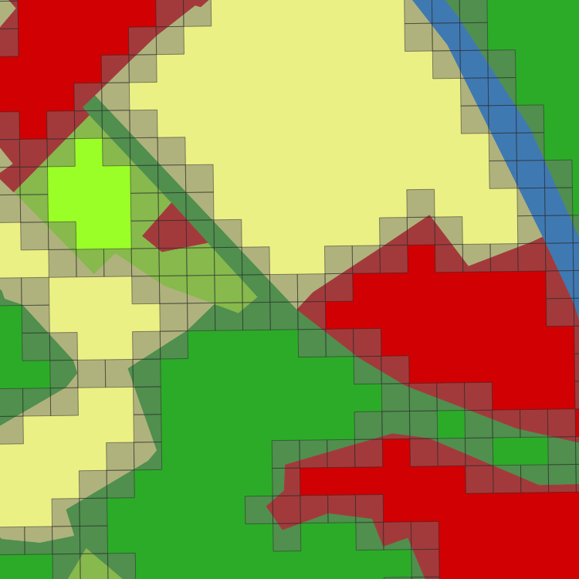
Class Imbalance – Addressing the Issues
only use samples containing two or more classes
focus on differentiation of classes
reduces class imbalance, because large patches are dropped
Notes:
forest 61,64%
buildings 13,53%
urban greens 2,53%
agriculture 20,86%
water 0,97%
traffic 0,48%

Slide 24
Image Segmentation
Experiments
Faculty of Mathematics and Computer Science
Karsten Köhler, Student ID No. 8690570

Slide 25



Implementation and Hardware Specifications
Intel Core i7 8700K 6x3.70 GHz
DDR4-2400 RAM, 32 GB
GeForce GTX 1080 Ti, 11 GB VRAM
Samsung SSD 860 EVO, 500 GB
Windows 10, Version 2004

Slide 26
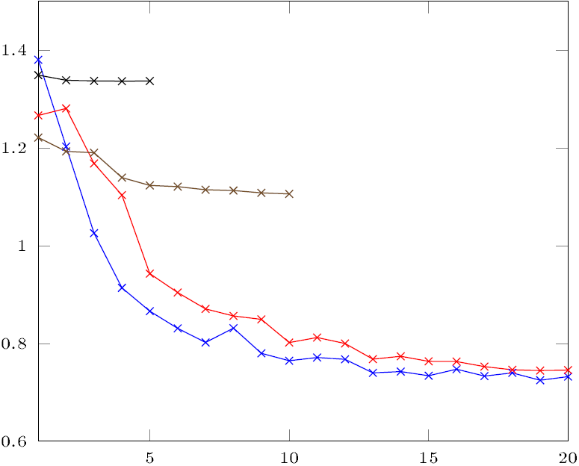
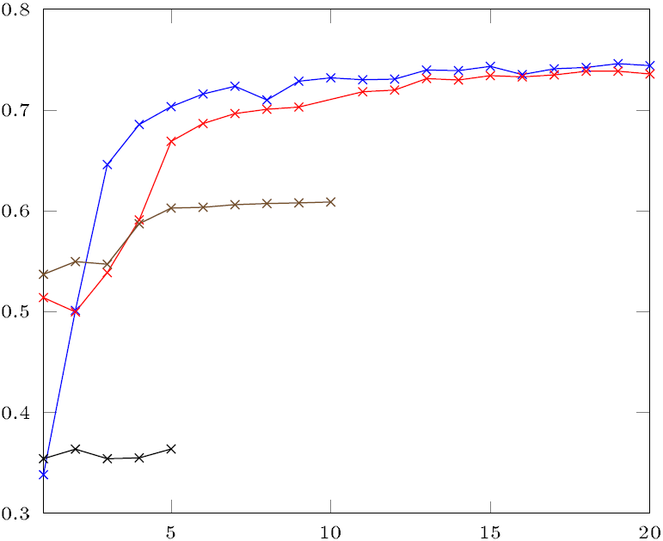
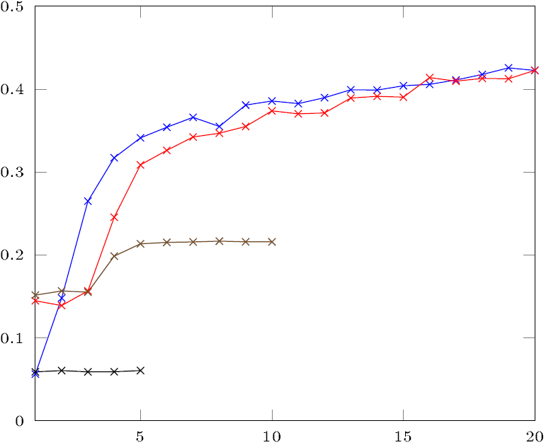
U-Net Metrics
Loss
 | Parameters (M) | Epochs | Loss | Cat. Accuracy (%) | Mean IoU (%)
Model
U-Net-23D | 16.6 | 20 | 0.7324 | 74.4 | 42.3
U-Net-23 | 16.6 | 20 | 0.7458 | 73.6 | 42.3
U-Net-18D | 4.3 | 10 | 1.1061 | 60.9 | 21.6
U-Net-28D | 16.5 | 5 | 1.3370 | 36.4 | 6.0
Cat. Accuracy
Mean IoU

Slide 27
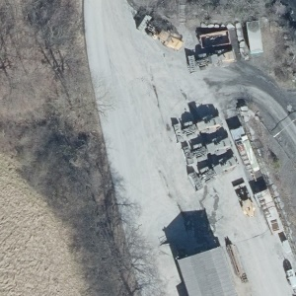
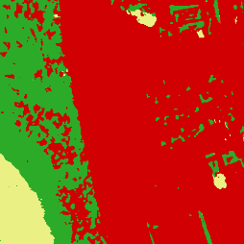

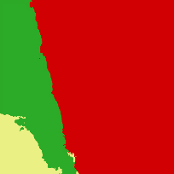
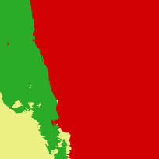

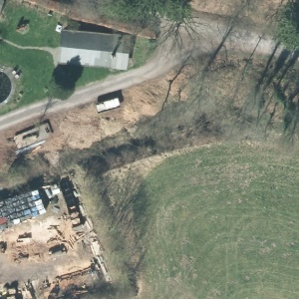
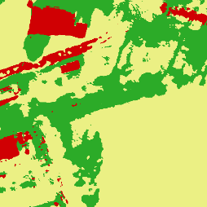

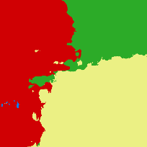
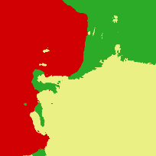





U-Net Predictions with Mean IoU
29.8%
40.0%
4.5%
20.9%
37.5%
61.8%
21.0%
33.4%
24.0%
37.9%
4.7%
18.0%
Original Image
Ground Truth
U-Net-23D
U-Net-23
U-Net-18D
U-Net-28D
(38.8 m edge length)

Slide 28



FC-DenseNet Metrics
Loss
 | Parameters (M) | Epochs | Loss | Cat. Accuracy (%) | Mean IoU (%)
Model
FCDN-103D | 10.8 | 20 | 1.1681 | 62.6 | 28.4
FCDN-103CD | 5.9 | 20 | 1.2952 | 55.9 | 24.0
FCDN-67D | 4.0 | 20 | 1.3301 | 53.7 | 23.2
FCDN-56D | 2.7 | 20 | 1.2806 | 56.1 | 21.8
Cat. Accuracy
Mean IoU

Slide 29


















FC-DenseNet Predictions with Mean IoU
56.0%
21.3%
15.6%
24.2%
50.6%
18.9%
16.2%
22.0%
26.9%
31.1%
30.1%
29.8%
Original Image
Ground Truth
FCDN-103D
FCDN-103CD
FCDN-67D
FCDN-56D
(22.4 m edge length)

Slide 30

W-Net Metrics
Loss
 | Parameters (M) | Epochs | Loss
Model
W-Net-36D-6 | 8.6 | 1 | 1.5142
W-Net-46D-6 | 33.3 | 1 | 1.5154
W-Net-36D-20 | 8.6 | 1 | 1.5137
W-Net-46D-20 | 33.3 | 1 | 1.5142

Slide 31



W-Net Class and Restoration Predictions
Original Image
W-Net-36D-6
W-Net-46D-6
(25.6 m edge length)

Slide 32


W-Net Class and Restoration Predictions
Original Image
W-Net-36D-20
W-Net-46D-20
(25.6 m edge length)

Slide 33
Image Segmentation
Discussion
Faculty of Mathematics and Computer Science
Karsten Köhler, Student ID No. 8690570

Slide 34








Comparison – U-Net vs. FC-DenseNet
Original Image
Ground Truth
U-Net-23D
FCDN-67D
U-Net-23D
coarse predictions
processing time: 9 seconds
FCDN-67D
fine-grained predictions
processing time: 11 seconds
36.3%
22.9%
41.7%
26.9%
(580 m edge length)
Notes:
for entire dataset:
U-Net 110 minutes
FCDN 135 minutes

Slide 35
Discussion
W-Net performed very poorly
no directly usable results
Recommendation
Try semi-supervised instead of unsupervised learning.

Slide 36
Discussion
good predictions from U-Net and FC-DenseNet
predictions can be further improved
Recommendation
Ground Truth needs to be more accurate. More balanced dataset would be beneficial.

Slide 37
Vegetation Analysis
Literature Review
Faculty of Mathematics and Computer Science
Karsten Köhler, Student ID No. 8690570

Slide 38

Spectral Vegetation Indices
vegetation reflectance
indicate vegetation health and density
based on reflectance in electromagnetic spectrum
various indices available
near-infrared
green
blue
red
400 nm
450 nm
500 nm
550 nm
600 nm
650 nm
700 nm
← ultraviolet
visible light
infrared →

Slide 39
Vegetation Analysis
Experiments
Faculty of Mathematics and Computer Science
Karsten Köhler, Student ID No. 8690570

Slide 40





Ratio Vegetation Index (RVI)
Original Image
RVI
20
$$RVI= \frac{NIR}{Red}$$
10
Properties
lower limit is 0
no upper limit
0
Horning et al. (2003)

Slide 41



Normalized Difference Vegetation Index (NDVI)
Original Image
NDVI
+1
$$NDVI= \frac{NIR−Red}{NIR+Red}$$
0
Properties
limited to range -1 to +1
< 0 is mostly water
-1
Weier et al. (2000)

Slide 42



Enhanced Vegetation Index (EVI)
Original Image
EVI
+1
$$EVI=G⋅\frac{NIR−Red}{NIR+C_{1}⋅Red−C_{2}⋅Blue+L}$$
$$G=2.5; C_{1}=6;C_{2}=7.5;L=1$$
0
Properties
limited to range -1 to +1
< 0 is mostly water
-1
Huete et al. (2002)

Slide 43




Soil-Adjusted Vegetation Index (SAVI)
Original Image
SAVI
20
$$SAVI=\left(\frac{NIR−Red}{NIR+Red+L}\right)⋅\left(1+L\right)$$
$$L=0.5$$
10
Properties
takes soil variations into account
0
Huete et al. (1988)

Slide 44



Modified Soil-Adjusted Vegetation Index (MSAVI)
Original Image
MSAVI
80
$$MSAVI=\frac{2NIR+1−\sqrt{{\left(2NIR\right)}^{2}−8(NIR−Red)}}{2}$$
40
Properties
automatically adjusted based on soil variations
0
Qi et al. (1994)

Slide 45
Vegetation Analysis
Discussion
Faculty of Mathematics and Computer Science
Karsten Köhler, Student ID No. 8690570

Slide 46





Discussion
vegetation indices yield contradictory results
reliable predictions are virtually impossible
?
RVI
NDVI
EVI
SAVI
MSAVI
Vegetation Density Prediction

Slide 47
Discussion
optimized for very specific set of hardware
only green vegetation, no dead vegetation, no other obstacles
no information about height and robustness
is subject to frequent changes
Recommendation
With the present results, vegetation indices cannot be used in a reliable way. Further research on this topic is required.

Slide 48
Conclusion
Final Thoughts
Faculty of Mathematics and Computer Science
Karsten Köhler, Student ID No. 8690570

Slide 49
Conclusion
U-Net and FC-DenseNet both provide respectable predictions
W-Net had no marketable outcome, further research possible
Dataset needs more accurate labels and more diverse terrain
Many concerns regarding use of vegetation indices, further research possible

Slide 50
References
N. Horning, C. Russell: Global Land Vegetation - An Electronic Textbook. Chapter 4: Plant and Vegetation Community Properties. 2003.
G. Huang, Z. Liu: Densely Connected Convolutional Networks. 2017.
A. Huete, K. Didan: Overview of the radiometric and biophysical performance of the MODIS vegetation indices. 2002.
A. Huete: A soil-adjusted vegetation index (SAVI). 1988.
S. Jégou, M. Drozdzal: The One Hundred Layers Tiramisu: Fully Convolutional DenseNets for Semantic Segmentation. 2017.
J. Qi, A. Chehbouni: A Modified Soil Adjusted Vegetation Index. 1994.
O. Ronneberger, P. Fischer: U-Net: Convolutional Networks for Biomedical Image Segmentation. 2015.
J. Weier, D. Herring: Measuring Vegetation (NDVI & EVI). 2000.
X. Xia, B. Kulis: W-Net: A Deep Model for Fully Unsupervised Image Segmentation. 2017.

Slide 51
Thank you!
Question & Discussions
Faculty of Mathematics and Computer Science
Karsten Köhler, Student ID No. 8690570

